Slide 1
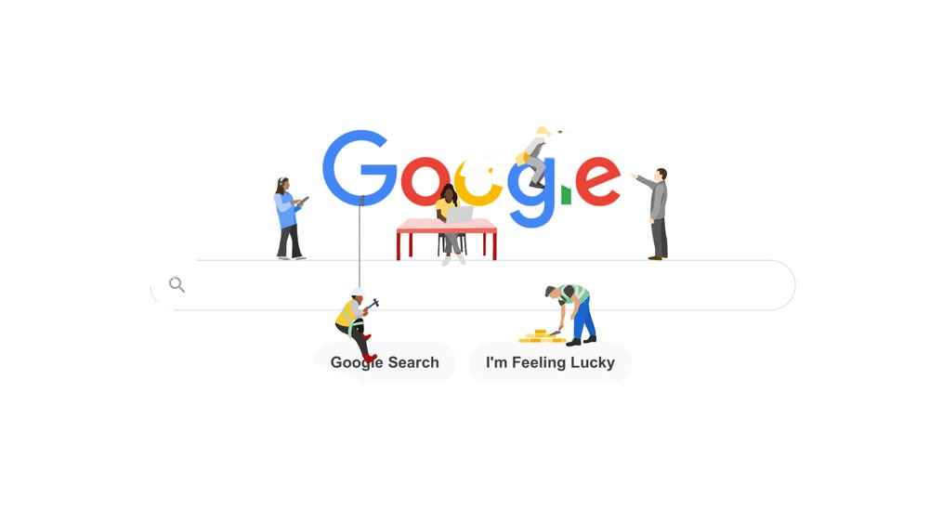
POPULAR WEBSITES

Slide 2

Objectives
Individual and Group work
Be able to search by yourself
Be able to identify different types of website
Be able to present your search results to others

Slide 3






EXPLAIN
Research Timeline
10 MIN
Session 1
Session 2
Session 3
TEAM: Quiz your classmate
TEAM: Search to find 1 website related to category
TEAM: Share to your partner about your understanding on the website
INDIVIDUAL: Check and Test a website following question provide by teacher
TEAM: Demo to your classmate about your website (1 student click the website and 1 student present).
Note: no need to create PowerPoint Slide
TEAM: Create a quiz for check your classmate understanding about your presentation for next session.
Notes:
Teacher to-do: - Choose students pairs by teachers
- Pick up one category

Slide 4
EXPLAIN
Website Categories
10 MIN
eCommerce
Video sharing
Blog
Portfolio
Event
Educational
Notes:
https://www.wix.com/blog/2020/12/types-of-websites/

